Slide 1
Unveiling Insights: Targeted Marketing Campaign
Presented by: Ifeanyi Udeze
Last Updated: 10 July 2023

Slide 2
Unveiling Insights: Targeted Marketing Campaign
Purpose Statement
Data Sources and Methodology
Data Story (with Visuals)
Summary of Insights and Recommendations
Net Steps and Questions
Appendix

Slide 3
Purpose Statement

Slide 4
Objective
Identify possible customer segments using personal, geographic, revenue, and/or purchase data to support the marketing stakeholders in launching a targeted campaign.

Slide 5
Data Sources and Methodology

Slide 6
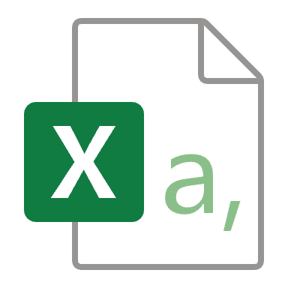
Data Sources
customers.csv
purchases.csv
Data Methodology
Data Modelling
Create date table
Create relationships
Data Analysis
Measures
Report building
Data Cleaning
Identify keys
Column profiling
Expand JSON Array

Slide 7
Data Story

Slide 8
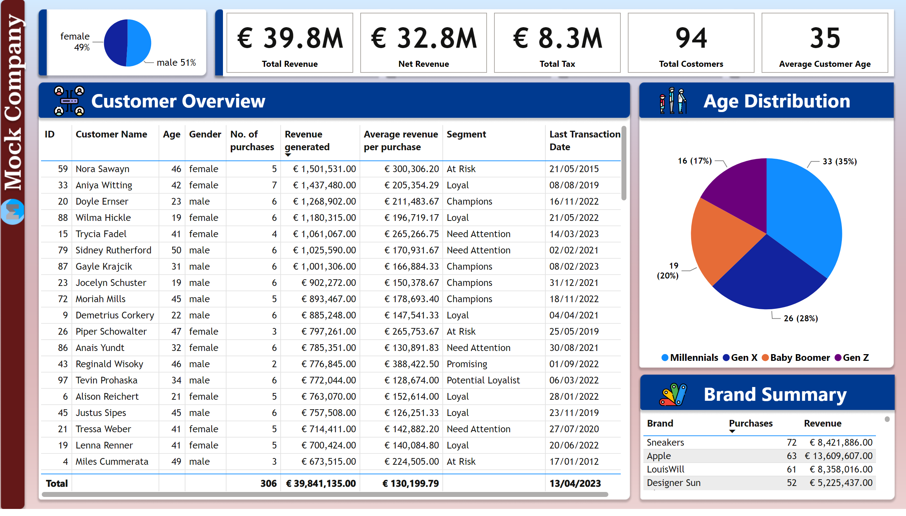
Customer Overview
Notes:
1. Customer Overview - At a glace, purchasing power differs. Some customers have make large EUR but fewer purchase hence the need for customer segmentation
2. Segmentation - Age Distribution (64% Millenials and Gen X) and Gender

Slide 9
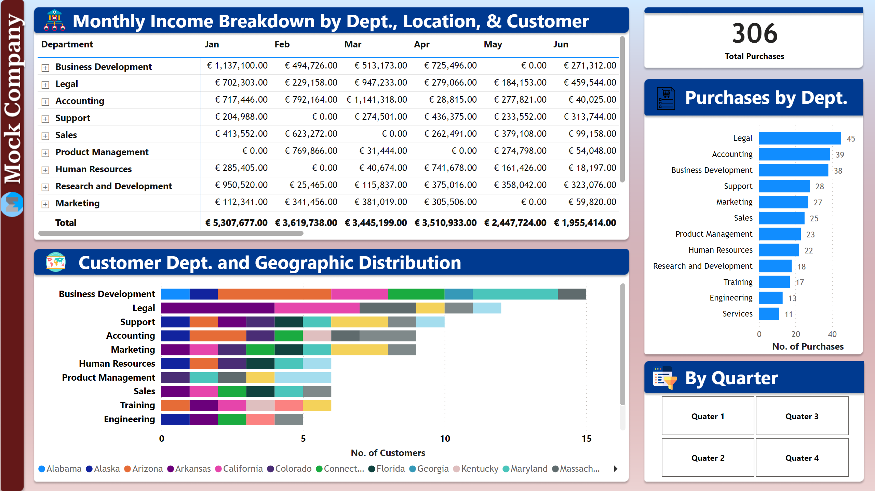
Geographic Distribution
Notes:
Customer Dept. and Geographic Distribution
Monthly Income sorted by total revenue. Can be drilled to location (company city and individual customer)
38% of customers from top 3 departments (out of 12). Similar with number of purchases and revenue (36%)

Slide 10
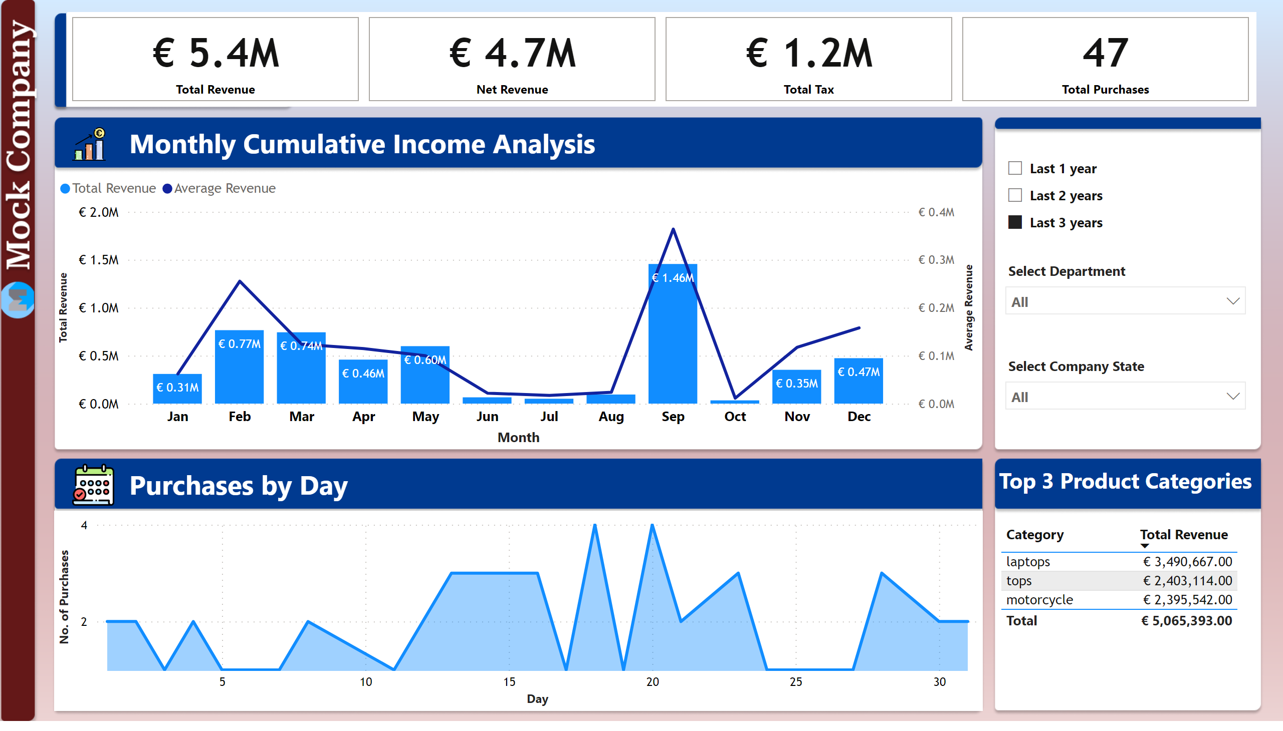
Income Analysis
Notes:
Average Revenue gives us the purchase per item for the month. For instance, Feb and Mar were similar but…
September is 2021 was 1.14mEUR so it should not deceive
Spending is higher in the first half of the year so targeted campaigns should start from October through May
The data can be sliced by department and location on the actual dashboard

Slide 11
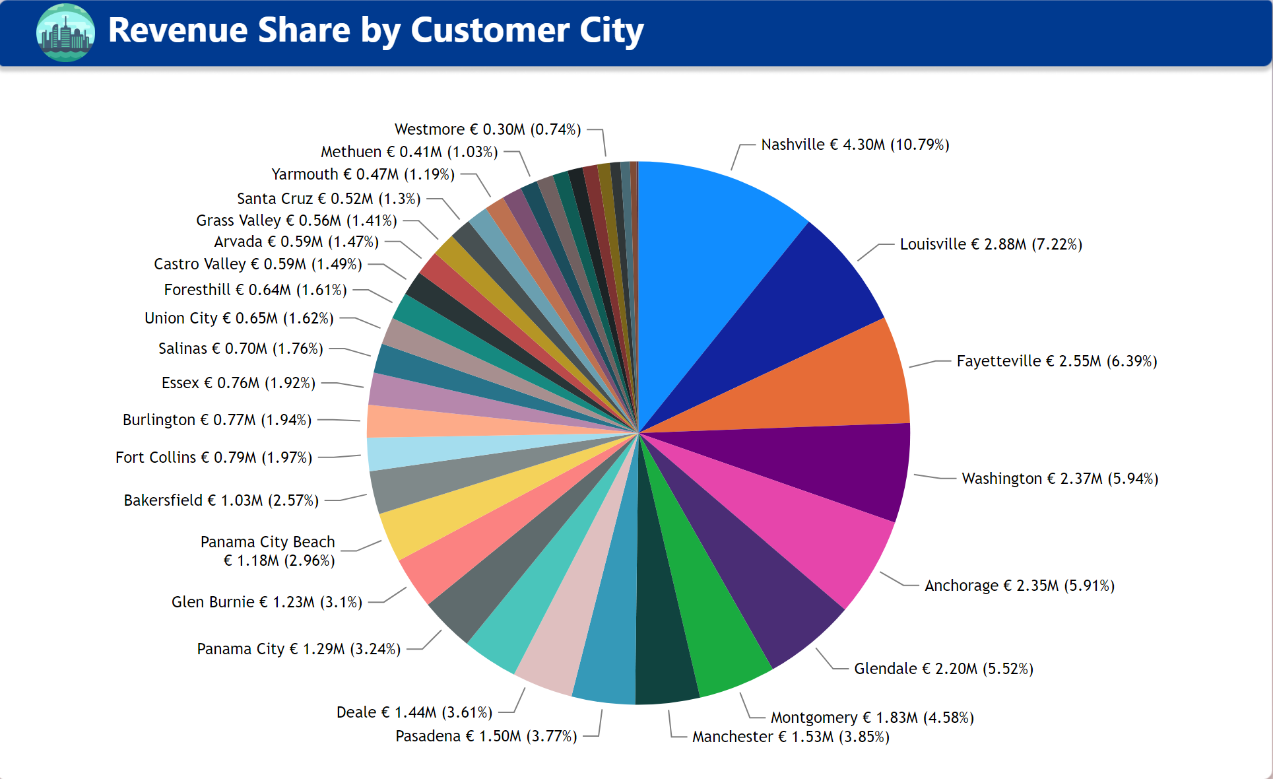
Revenue Share
Notes:
Nashville, Louisville, and Fayetteville make up 25% of the company’s Total Revenue
Joke about ”ville”
We can use this data to make recommendations for targeted campaigns

Slide 12
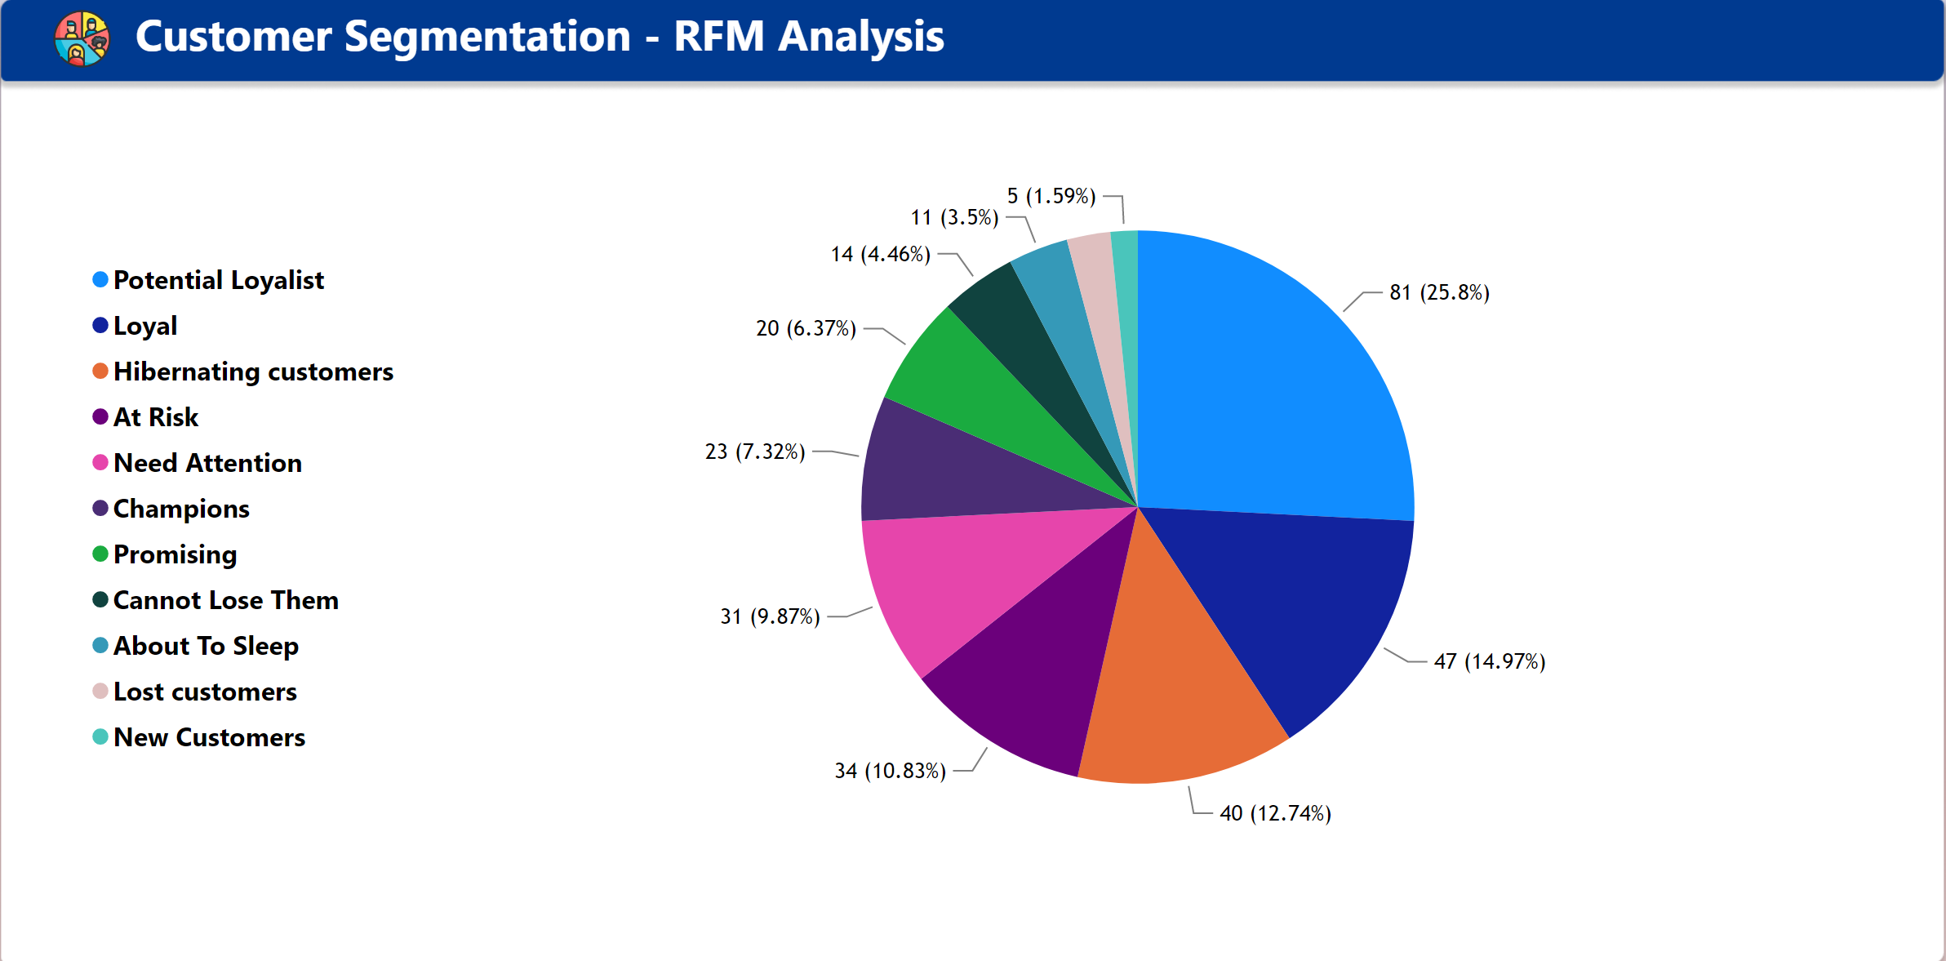
Customer Segmentation
Notes:
RFM analysis segmentation, highlighting the different customer segments based on recency, frequency, and monetary value for a certain period.
For Recency, we consider the customer’s most recent purchase
For Frequency, we consider how many purchases the customer has made
For Monetary, we consider how much they have spent per purchase

Slide 13
Insights and Recommendations

Slide 14
Insights and Recommendations
Data validation rules should be implemented for each unique identifier (username, id) to check for duplicate entries before new data is added to the database.

